Slide 1
Tutorial 5
Statistical Computation and Analysis
Spring 2025

Slide 2
Tutorial Outline
Normal distribution
Student’s t distribution
Prior predictive checks
Posterior predictive
Groups comparison

Slide 3
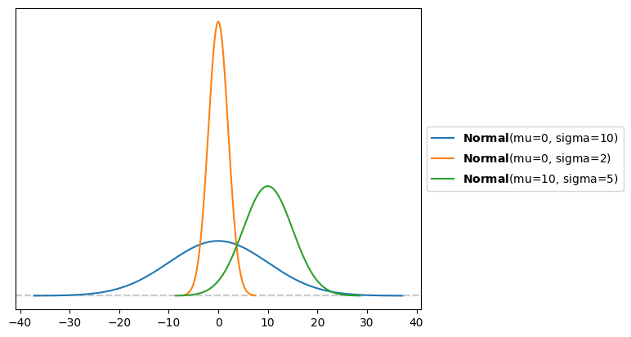

Normal Distribution
Characterized by two parameters:
$μ$
$σ$
If we model our data using a normal distribution, we will have a posterior distribution for each parameter.

Slide 4
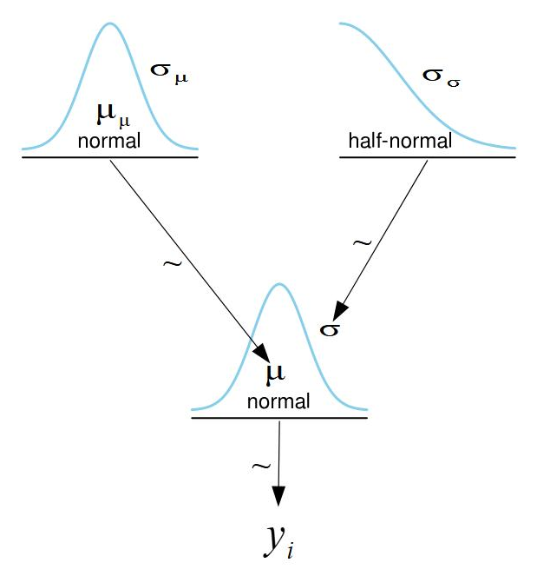

Normal Distribution
Each parameter needs its own prior
Two priors
We will use a normal prior for $μ$
Softer prior than uniform
And a half normal prior for $σ$
Cannot be negative
Notes:
Conjugate:
mu (when var is known) – normal
Var (when mu is known) – inverse gamma .
The sigma of the half normal is the sigma of the normal distribution had it been whole and not half.

Slide 5
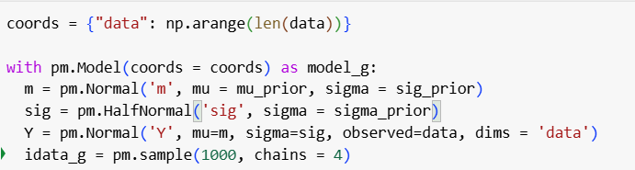
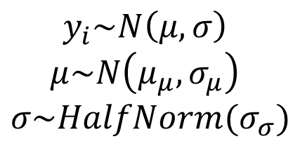
Normal Distribution
Graphical model
Equations
PyMC
$$y_{i}\sim N\left(μ, σ\right)$$
$$μ\sim N\left(μ_{μ}, σ_{μ}\right)$$
$$σ\sim HalfNorm(σ_{σ})$$
Notes:
Conjugate:
mu (when var is known) – normal
Var (when mu is known) – inverse gamma
Y – comma, dims – “data”

Slide 6
Data Collection
How long does it take you to do a Statistics homework assignment in minutes?
https://docs.google.com/forms/d/e/1FAIpQLSeZ3_hrngoUDsQAM00WbY-097Q2D1t7ymABgFQDi3oavJzgnw/viewform?usp=dialog
Let’s model this data using a normal distribution
Notes:
Data – how much time do you spend on assignments – some probably finish much faster or slower

Slide 7
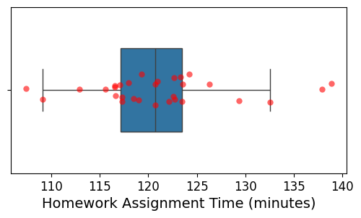
Plot Data (Simulated)
Box plot
Line inside the box: median
The box: quartiles (25th and 75th percentiles)
Whiskers: Range excluding outliers
Dots: outliers (usually more than 1.5 IQR beyond IQR)
Notes:
Data – how much time do you spend on assignments – some probably finish much faster or slower/
Can the prior generate the data that we have?

Slide 8

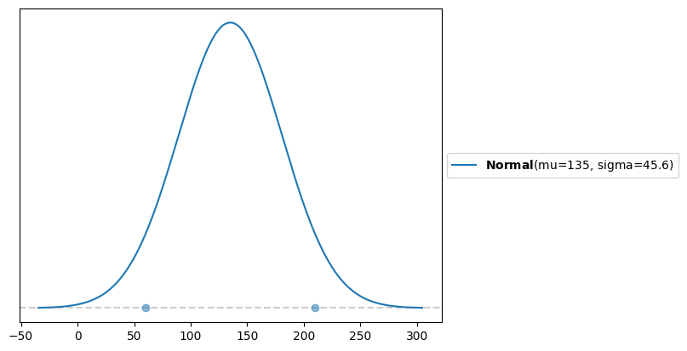
Priors

Slide 9
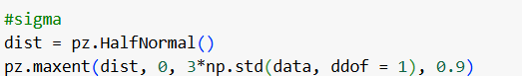
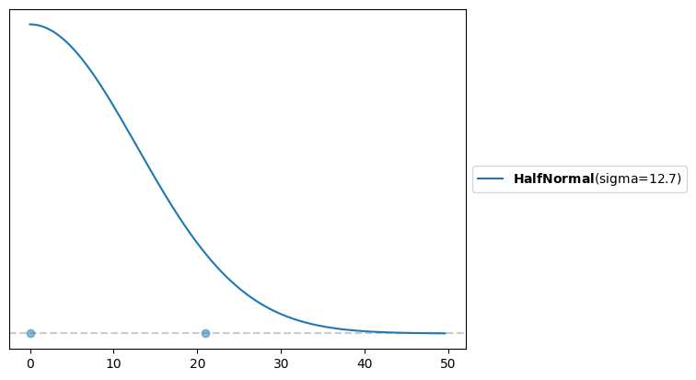
Priors
Notes:
Distribution allows values up to $≈3σ$
What is a good guess for the width of the prior of sigma?
I chose wide to take into account that I had no idea what kinds of answers I would get from them.
But maybe the range of the data, or the range of the data/2.

Slide 10
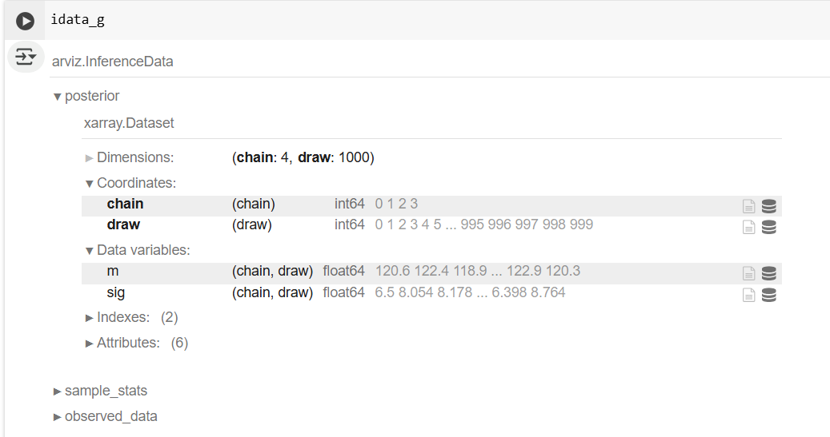
Posterior
We have four chains for each the mu and the sigma
They were sampled jointly

Slide 11
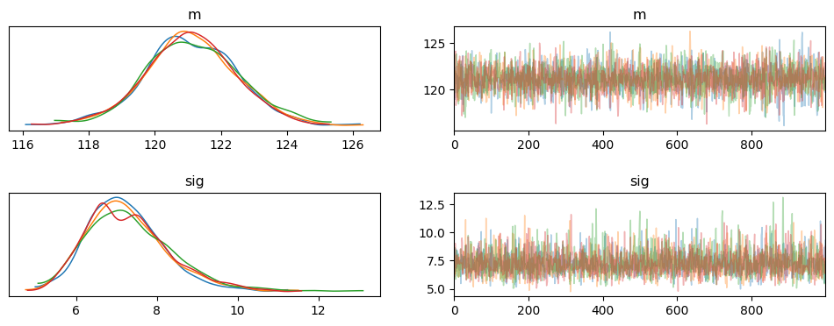
Posterior
KDE
The chains overlap

Slide 12
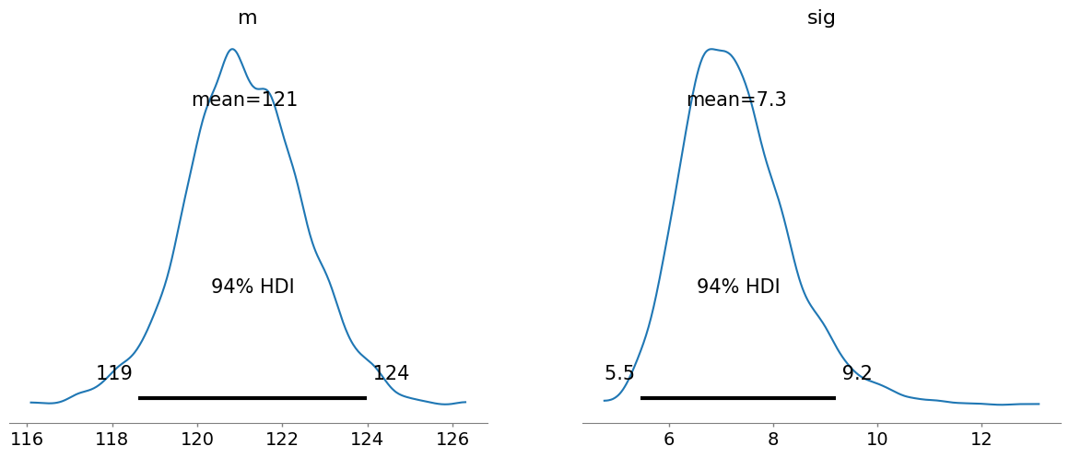
Posterior
94% HDI

Slide 13
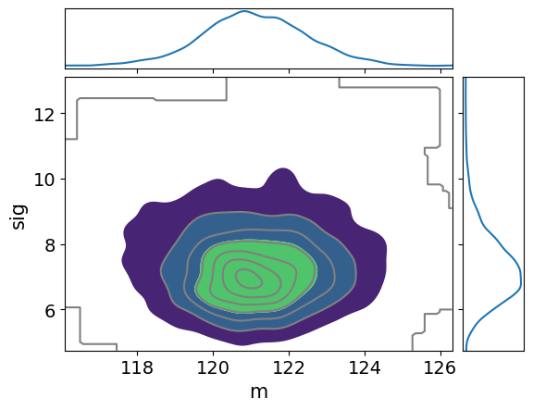
Posterior
They were sampled jointly
Every sample has each a value for mu and one for sigma
Are they correlated?
Not really (one doesn’t grow or shrink
with the other)

Slide 14
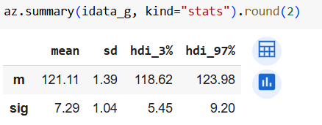
Posterior
Let’s print the statistics

Slide 15
Bayesian Workflow
Data
Model
Sample
Posterior
Inference

Slide 16
Prior Predictive Checks
The priors are distributions
Sample values of the priors
Input them into the distribution describing the data
Sample datasets
This is about checking the priors, not the posterior
Notes:
Predictive - sample values of the priors. Put them into the distribution describing the data. Then sample datasets.
We're much more comfortable with what the data should look like than what the priors should look like.
For example, the min and max heights. It shows us what the data is going to look like under this set of priors.
If we picked priors, even if they make sense. But then the data (observed) isnt possible given, then there's something wrong. The data has to be apriori possible and reasonably liekly. Now, we do this check just based on checking. Ppl don’t tend to do a lot of statistics.
The posterior predictive we will have statistics.

Slide 17
Prior Predictive Checks
What does this give us?
We’re more comfortable with what the data should look
like than with what the priors should look like.
This shows us what the data would look like under this set
of priors.
If we picked priors that make sense, but the data we collected is not possible given these priors:
Something’s wrong with the priors
Something’s wrong with the data

Slide 18
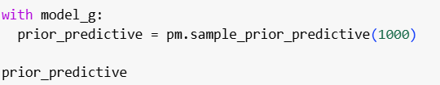
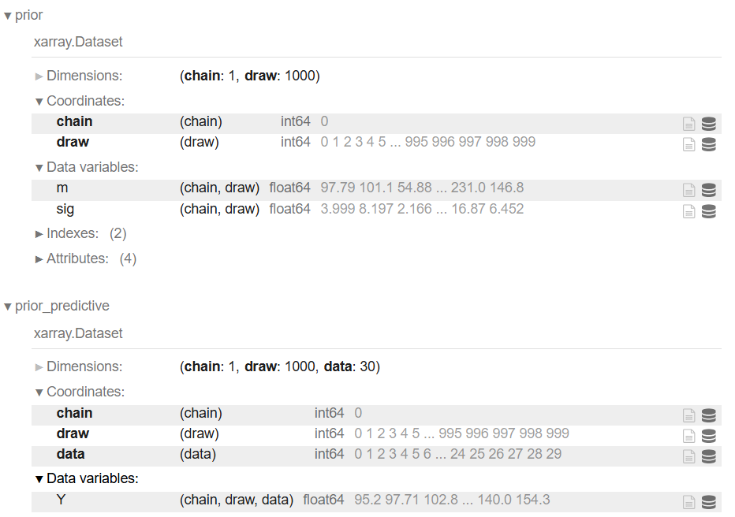
Prior Predictive Checks

Slide 19
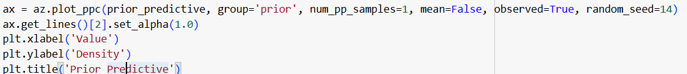
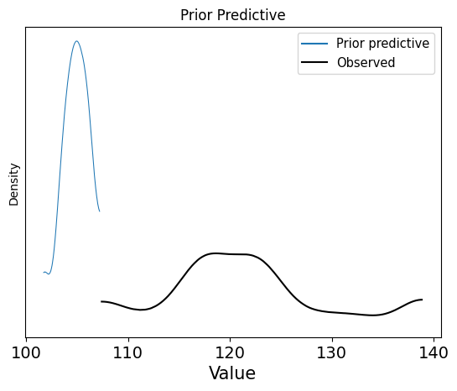
Prior Predictive Checks

Slide 20
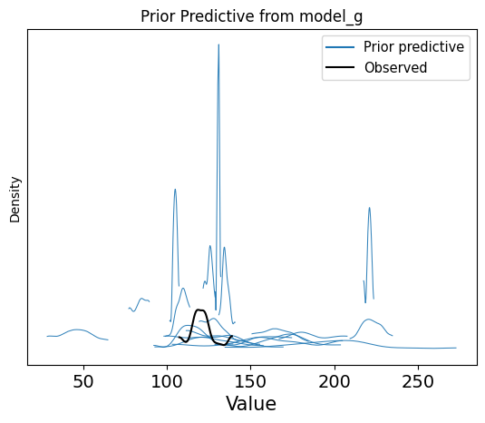
Prior Predictive Checks
The observed data should be possible.
And the possible datasets should be possible.

Slide 21
Bayesian Workflow
Data
Model
Sample
Posterior
Inference
Prior predictive sampling

Slide 22
Posterior Predictive Checks
Check ability of model to explain data
Pick parameters from posterior distribution
Meaning, we are still choosing values for mu and sigma
And then getting data from our normal distribution using
those values.
However, in this case, mu and sigma are from the posterior and therefore take into account both the prior and the data as a result of the Bayesian Inference

Slide 23
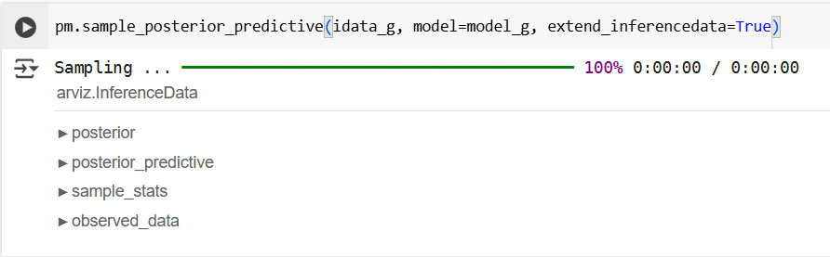
Posterior Predictive Checks
Notes:
We added the data to our xarray

Slide 24
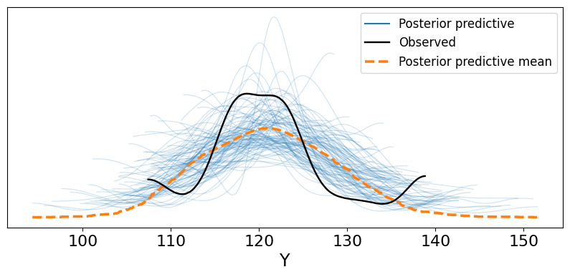
Posterior Predictive Checks
The posterior predictive data has a shifted mode
The posterior predictive data has larger variance
The posterior predictive data has lighter tails
Pretty good
Outliers
Notes:
The variance needs to increase in order to capture the outlier data

Slide 25
Bayesian Workflow
Data
Model
Sample
Posterior
Inference
Posterior predictive sampling
Prior predictive sampling

Slide 26
Bayesian Workflow
Diagnostics
Data
Model
Sample
Posterior
Inference
Posterior predictive sampling
Prior predictive sampling

Slide 27
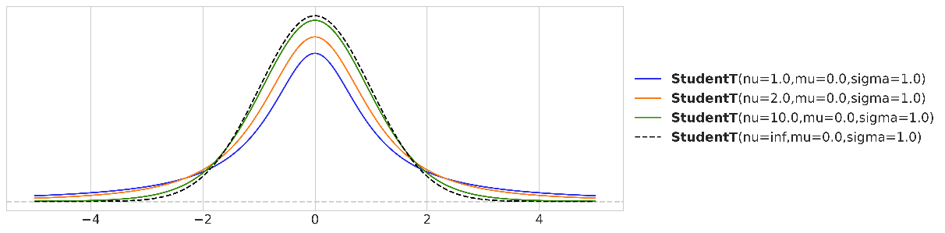

Student’s t-distribution
Similar to Normal distribution but with thicker tails
Has a parameter $ν$, which is the normality parameter (or degrees of freedom)
Converges to normal distribution as 𝜈→∞

Slide 28
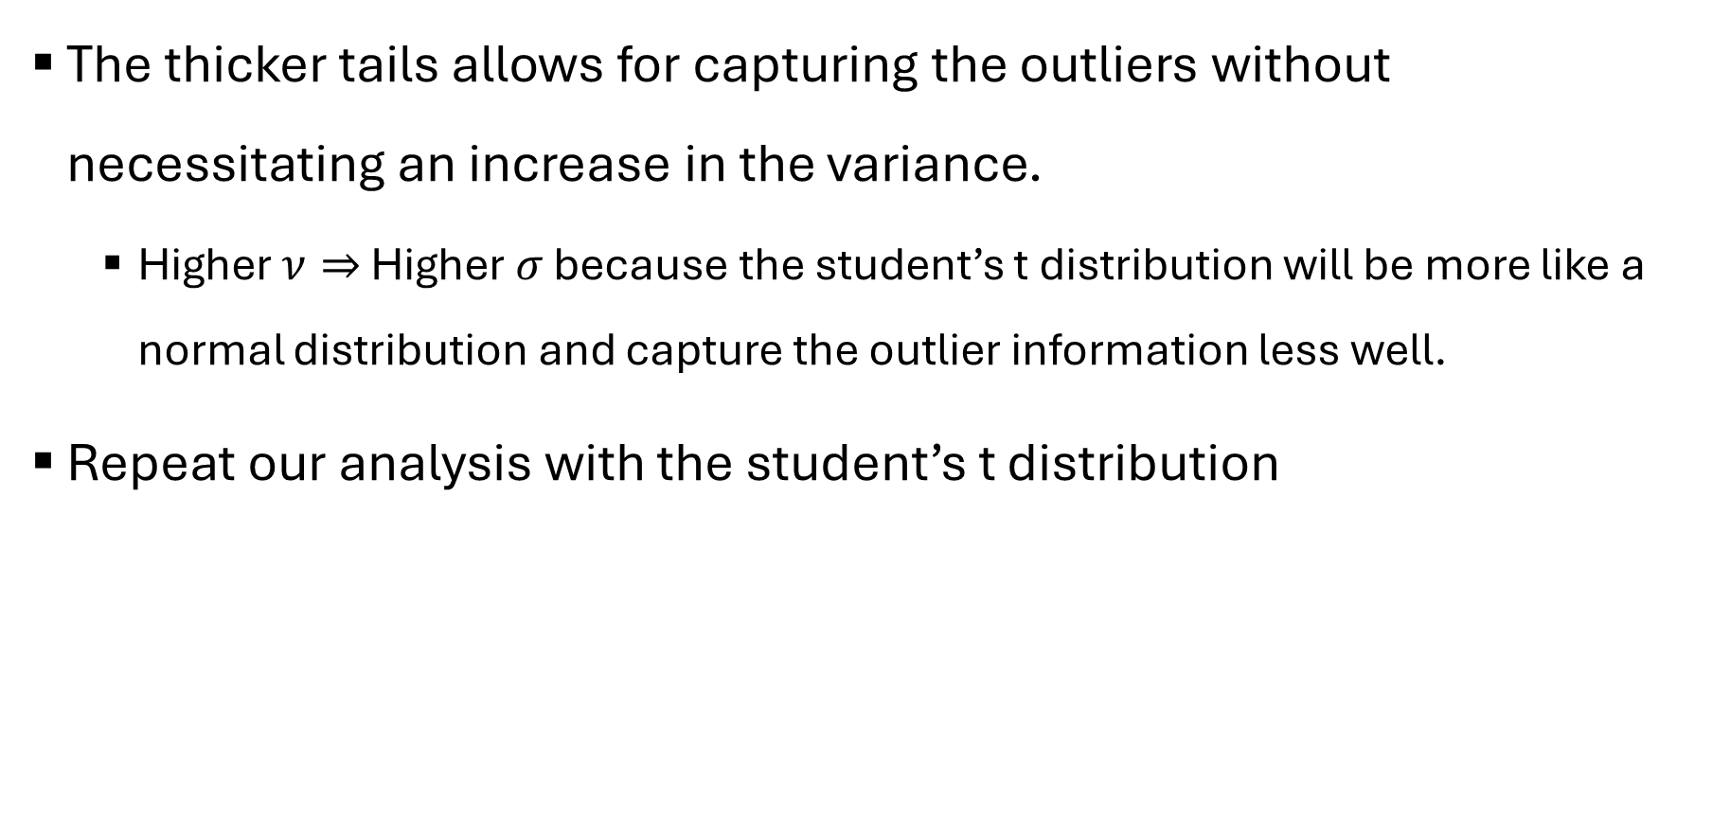
Student’s t-distribution
The thicker tails allows for capturing the outliers without necessitating an increase in the variance.
Higher $ν⇒$ Higher $σ$ because the student’s t distribution will be more like a normal distribution and capture the outlier information less well.
Repeat our analysis with the student’s t distribution

Slide 29
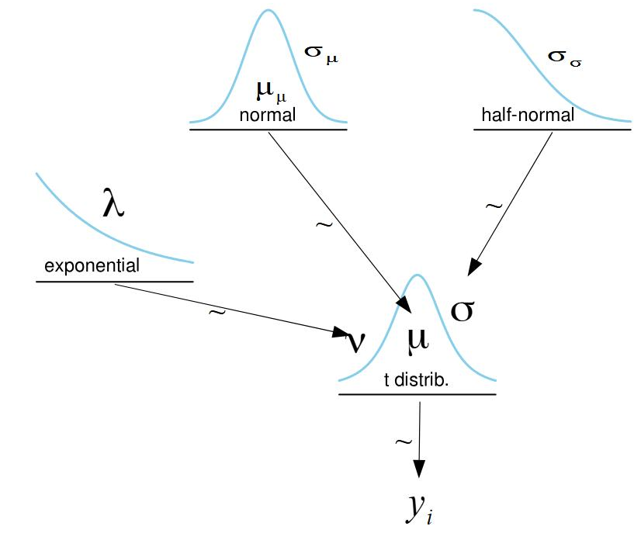
Student’s t-distribution
The thicker tails allows for capturing the outliers without necessitating an increase in the variance.

Slide 30
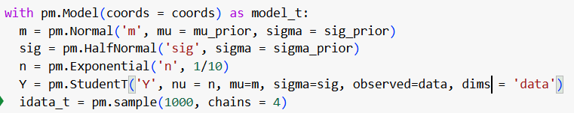
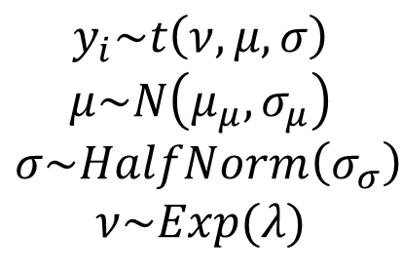
Student’s t-distribution
Graphical model
Equations
$$y_{i}\sim t\left(ν, μ, σ\right)$$
$$μ\sim N\left(μ_{μ}, σ_{μ}\right)$$
$$σ\sim HalfNorm\left(σ_{σ}\right)$$
$$ν\sim Exp(λ)$$
PyMC

Slide 31
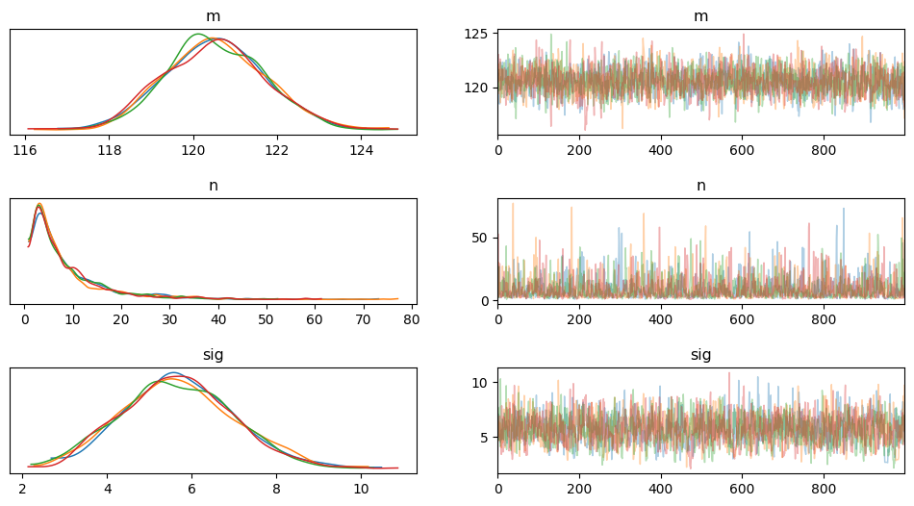
Posterior
KDE

Slide 32
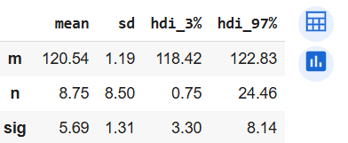
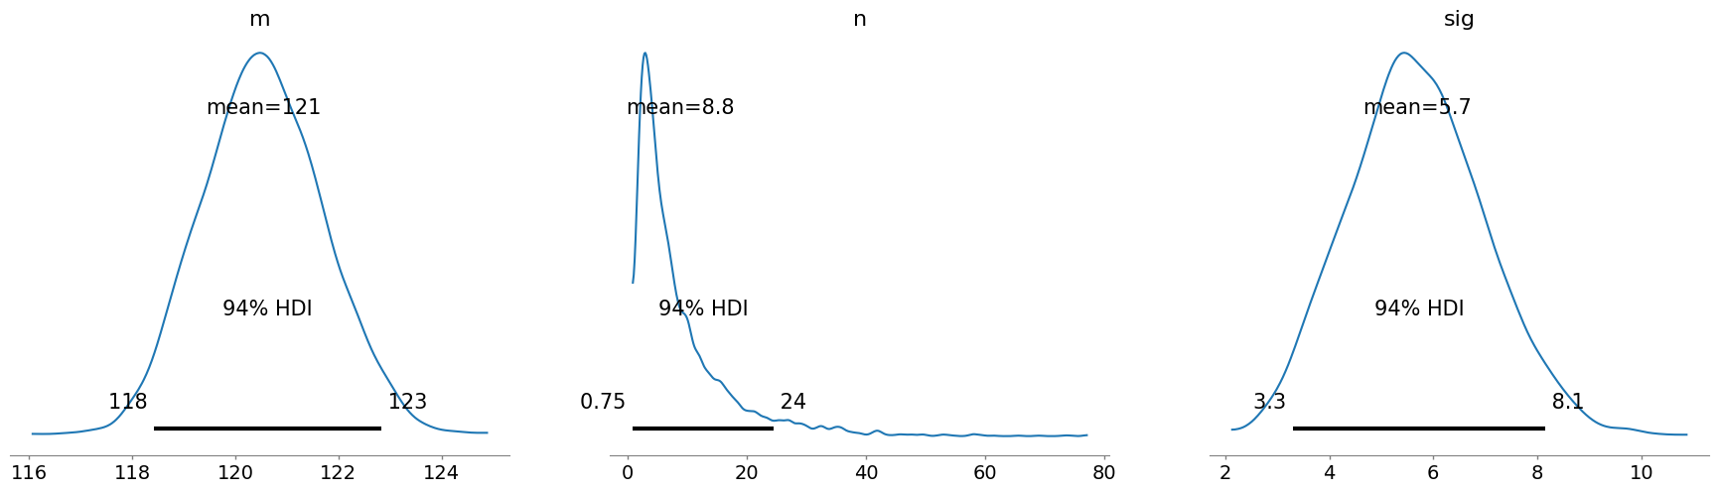
Posterior
94% HDI

Slide 33
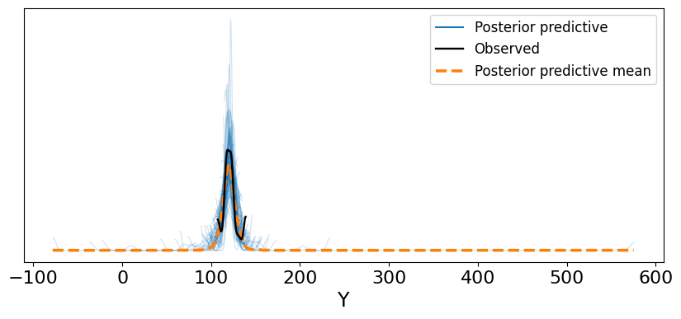
Posterior Predictive Checks
Better fit than the normal distribution

Slide 34
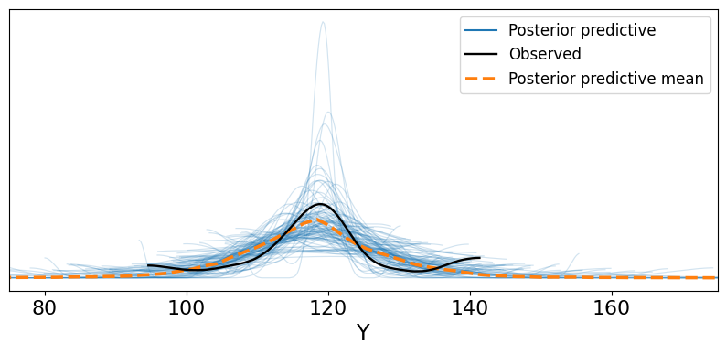
Posterior Predictive Checks
Better fit than the normal distribution

Slide 35
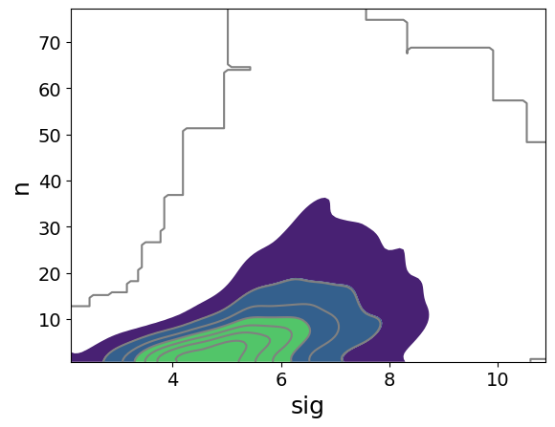
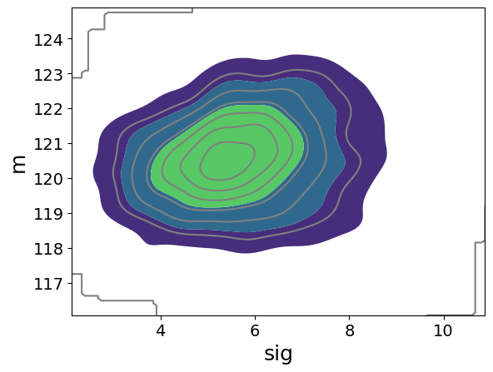
Correlations Between Parameters
Between nu and sigma
But not between sigma and mu

Slide 36
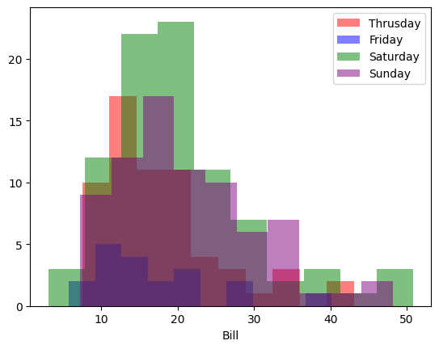
Groups Comparison
Let’s look at the tips dataset, but instead of comparing the tips on the different days, let’s compare the bill values on the different days.

Slide 37
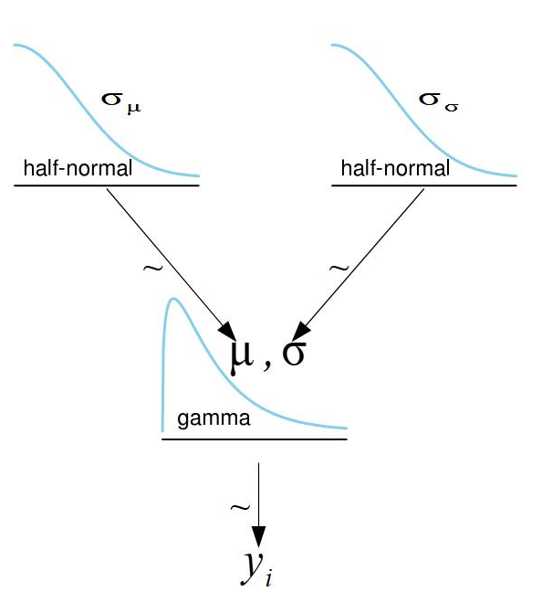
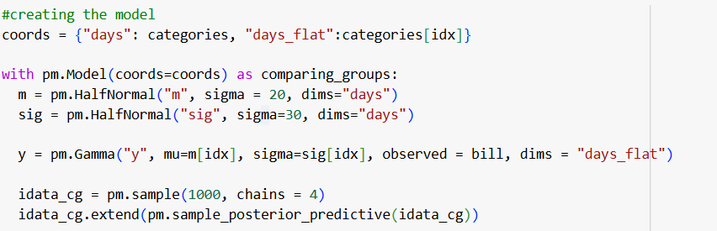
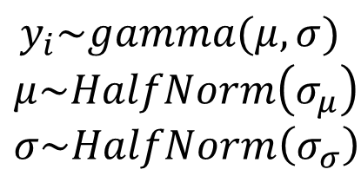
Groups Comparison
Let’s model the data for each day using a gamma distribution.
Graphical model
Equations
$$y_{i}\sim gamma(μ, σ)$$
$$μ\sim HalfNorm\left(σ_{μ}\right)$$
$$σ\sim HalfNorm\left(σ_{σ}\right)$$
PyMC
Notes:
Dims has the shpae in it. Slide 5 when the dims is the data.
what if we want a different prior for each day?
Can pass as vector. Different distributions - pytensor and stack command.
Gamma is good if you have a positive parameter and want to charaterize with two variables.
In general, look at preliz at the distribution gallery:
Choose continuous or discrete.
Choose bounded or not.
Choose skewed or symmetric.
Choose outliers (kurtosis)
Try a few and see what works.
Each group (4 days) has its own mean and std.
Every datapoint has its own mean based on which of the four days it is.
Coords dictionary – the days and the day of each datapoint.

Slide 38
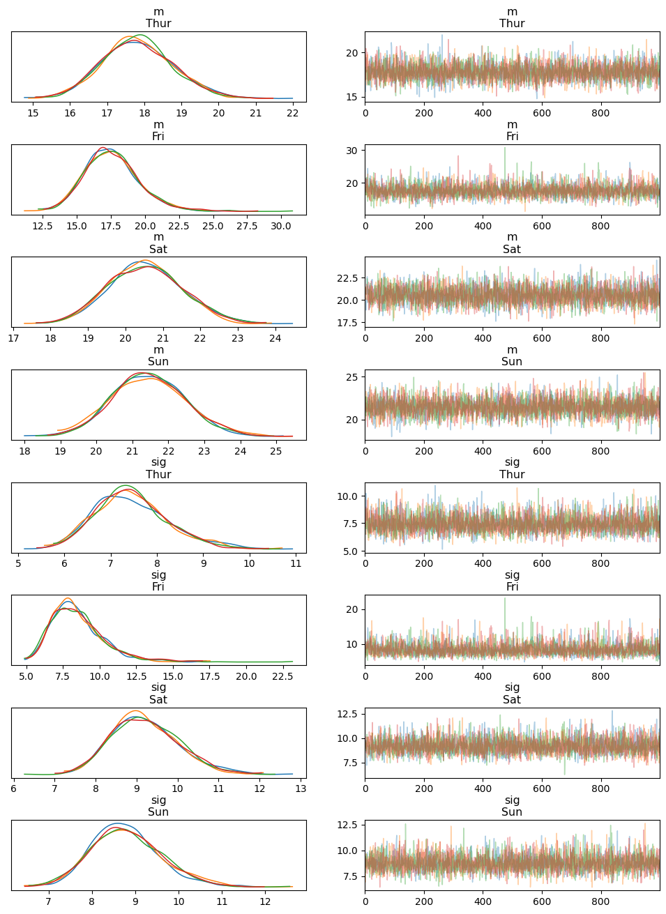
Groups Comparison
Look at KDE plots

Slide 39
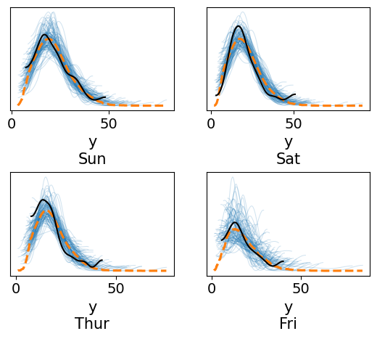
Groups Comparison
Posterior predictive checks
Notes:
Not bad.
Small sample size
Better than the modelling of the tips data
Maybe there is an effect of other factors such as gender on the data

Slide 40
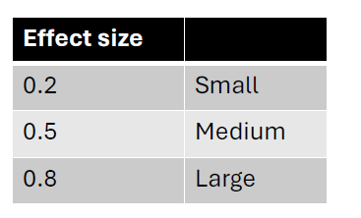
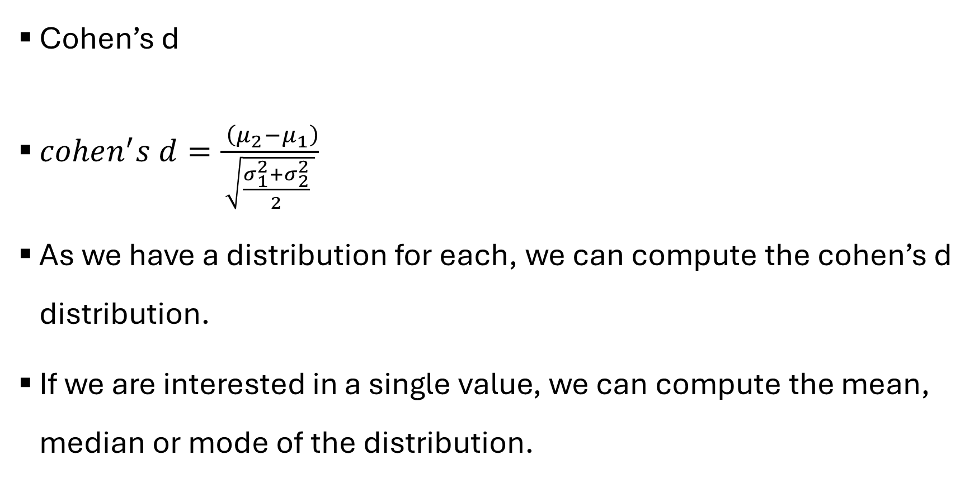
Groups Comparison
Cohen’s d
$cohen^{′}s d=\frac{ \left(μ_{2}−μ_{1}\right)}{\sqrt{\frac{σ_{1}^{2}+σ_{2}^{2}}{2} }}$
As we have a distribution for each, we can compute the cohen’s d distribution.
If we are interested in a single value, we can compute the mean, median or mode of the distribution.
Notes:
Mode - fit a kde - pretend its normal and fit something to the top
Effect size – not affected by sample size
Top – raw effect size
Bottom – size of noise

Slide 41
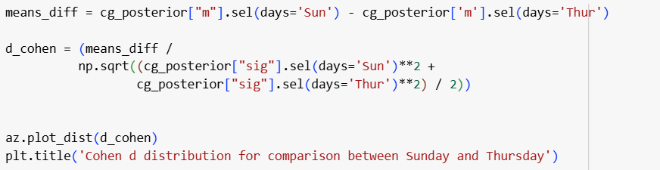
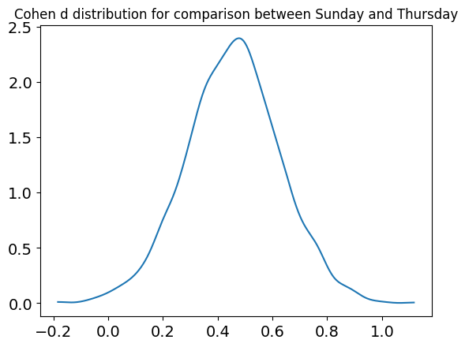
Groups Comparison
The distribution for comparing Sunday and Thursday
Notes:
ADD SMALL, MEDIUM AND LARGE TABLE

Slide 42
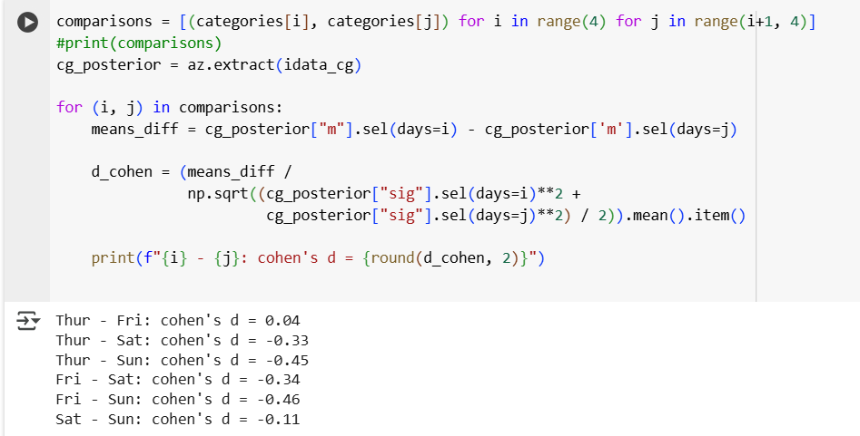
Groups Comparison

Slide 43
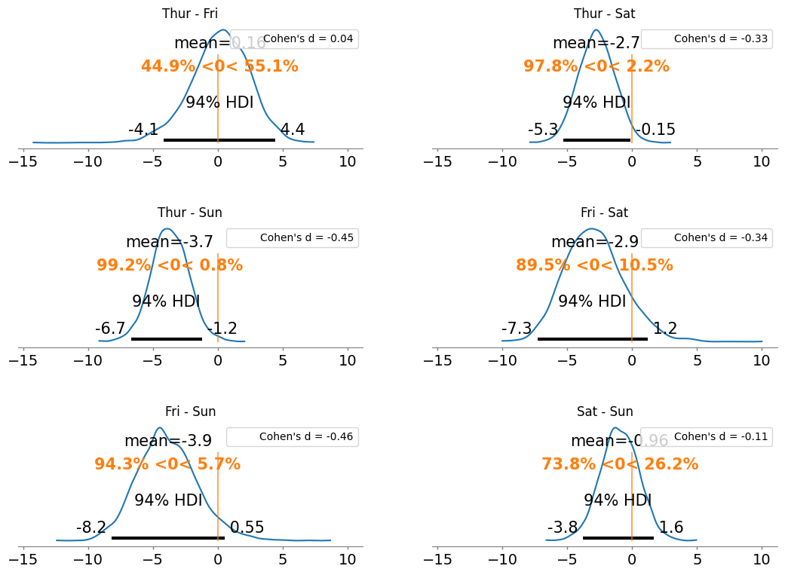
Distributions are the difference of means.
The orange shows how much of the distribution is above and below the set value (in this case 0 – no difference)

